Slide 1
Product Decisions
Unit 6

Slide 2
Concept
The product is the final product that the organization manufactures to earn profit by selling it. In the era of cutthroat competition, it becomes necessary that the product should be designed and sold in a prudent manner to satisfy both the customers and the financial leaves of the organization.
A product can be defined as a collection of physical, service and symbolic attributes which yield satisfaction or benefits to a user or buyer.
According to W. Alderson, “A Product is a set of tangible and intangible attributes, including packaging, color, price, manufacturers and retailer’s services, which the buyer may accept as offering the satisfaction of wants or needs.”
According to Philip Kotler, “a product can be offered to a market for attention, acquisition and consumption that might satisfy a need or want. It includes physical objects, services, persons, places, organizations and ideas.”

Slide 3
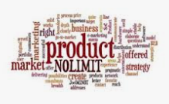

Slide 4
Products that are marketed include ;
• Physical goods
• Services
• Experiences
• Events
• Persons
• Places
• Properties
• Organizations
• Information
• Ideas

Slide 5
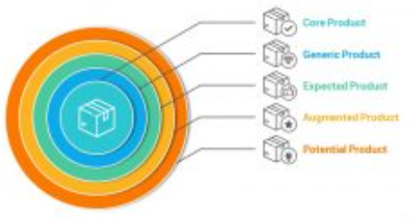
Levels of product
Product levels are used by sales experts to evaluate and allocate exactly how a product may satisfy the customers’ varied demands, needs, and wants. Businesses can achieve this by modifying and introducing goods that appeal to customers at various value levels or product categories. Philip Kotler developed a model that acknowledges that customers have five categories of demands, ranging from functional or fundamental needs to emotional needs. And they are the key to understanding major product decisions. This model also acknowledges that products are only tools for meeting the various requirements and desires of customers, while also paying attention to the NEEDS, WANTS, and DEMANDS of the customer. The 5 levels are mentioned below

Slide 6
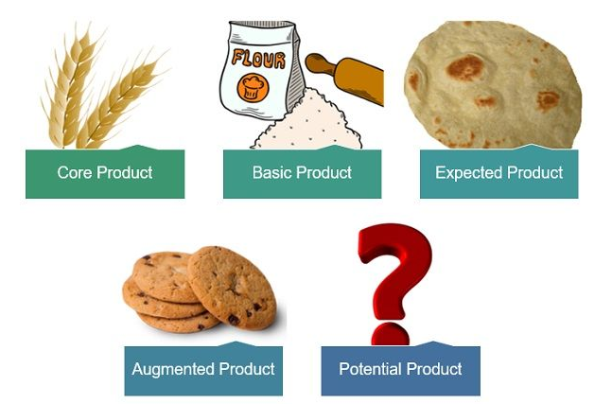

Slide 7
Core product benefit : It is the primary requirement or need that customers satisfy by consuming the good or service. For instance, while someone is away from home, a hotel offers a bed for them to sleep in, which serves as the core benefit of the hotel (product).
Generic product: It is the version of the product that just has the features or qualities required for it to work with no extra benefits. The generic product is a stripped-down version of the item that has only the functionality it needs to operate. For example- a phone that has only calling and SMS capabilities.
Expected product: It is the set of attributes that customers anticipate from a product when they purchase it is known as the expected product. The collection of qualities or traits that customers often anticipate and accept when they buy a product. For example, taking the same example of a mobile phone- one can expect a camera and internet capabilities while buying a phone.

Slide 8
Augmented Product: The incorporation of extra features, advantages, qualities, or associated services helps to set the product apart from those of its adversaries. These goods offer extra features, advantages, qualities, or associated technology benefits. For example, as mentioned above with the cell phone example- the unique selling point of the device can be its large display or high-megapixel camera.
Potential product: This covers all future augmentations and modifications a product might experience. A business should continue to enhance its products to delight as well as satisfy customers in the future to maintain their loyalty. For example, the phone company can pledge to make regular software updates to keep the device performance optimum.

Slide 9
Product Classification & Market Consideration
Product classification refers to the systematic categorization of products based on certain criteria such as their function, characteristics, composition, or use. This classification helps in organizing products into groups that share common attributes, which aids in inventory management, marketing strategies, regulatory compliance, and overall understanding of the market. There are various ways to classify products, including by industry standards, consumer behavior, regulatory requirements, or marketing purposes.
Market consideration involves analyzing various factors and conditions that can impact a business's ability to succeed in a particular market. This includes market size and growth, target audience, competition, market trends, pricing, distribution channel, marketing and promotion and customer needs.

Slide 10
Types of Product
Marketers perceive products as something that they’re going to offer in the market. However, they categorize the products into two broad categories; consumer products and industrial products.
Consumer Products
Convenience Product
Shopping Product
Specialty Product
Unsought Product
Industrial Products
Raw Materials
Fabricating Materials and Parts
Installations
Accessary Equipment
Operating Supplies

Slide 11
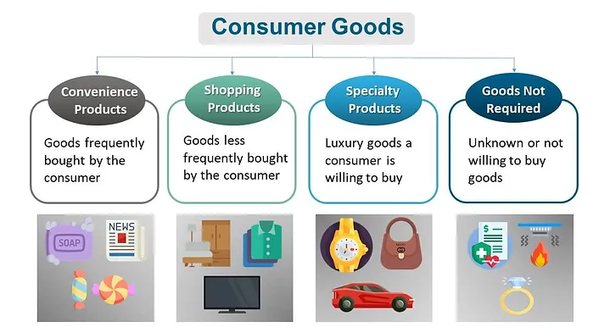

Slide 12
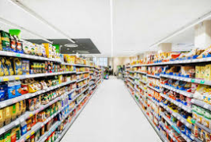
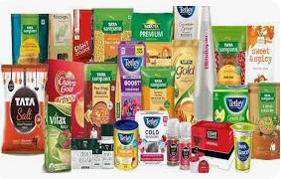
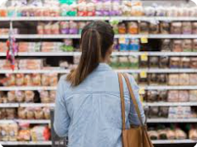
Consumer Product
Consumer products are the products that the customers buy for the sole purpose of consumption, instead of reselling it. The goal of consumer products is to satisfy and fulfill the needs and wishes of the consumers. Consumer products comprise almost everything ranging from a pen, books, jeans, sweater, camera, video recorder, and video games to edible items. It’s because of such a diverse variety; the marketers have no choice, but to further categorize them depending upon the buying process. The types of products under the category of consumer products are convenience products, shopping products, specialty products, and unsought products.

Slide 13
Convenience Product
Those products that the consumers want to purchase easily without any difficulty. They know what they want before buying them. They don’t want to spend their time making any purchase decision. The products that fall under the category of convenience products are the goods that the customers buy it frequently, casually, and immediately without making any comparison. Some of the main examples of convenience products are; candies, soap, milk, and all types of low-cost products that the customers don’t have any brand loyalty. The goal of marketers is to make such products readily available in the market. It’s because they require a mass distribution.
Marketers should keep one thing in mind that the consumers don’t perceive all the consumer products equally. For instance, Bread is one of the convenience product items, and some people use a particular brand. If a store doesn’t have a certain brand, then some other brand would take its place.

Slide 14
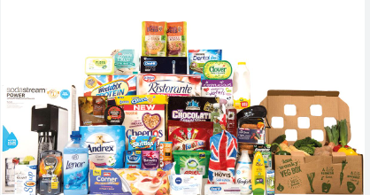
There are some brand loyal people of the convenience products, and they would visit some other store to find the brand. Therefore, marketers further categorize convenience products into three sub-categories;
Staple Goods: Staple goods are the products that the consumer buys it regularly and they’re brand loyal. Staple products are tobacco, pickles, soft drinks, ballpoint pens, etc. The reason for brand-loyal here is to make the purchase easier, you just buy the product one particular and lower the decision-making time.
Impulse Goods: Impulse goods are the products that the consumers buy it impulsively without paying any thought, it’s due to the sudden urge or needs to it. Like street food, magazines, ice cream, etc. Some people misunderstand the impulse goods that the consumers buy them irrationally. It’s no doubt that they don’t plan on buying it. When they do, it fulfills their needs and wishes. Therefore, they shouldn’t see them as a wasteful activity.

Slide 15
Emergency Goods: Emergency goods are closely similar to impulsive goods because you don’t plan for them. But they’re to some extent are different, because you get to plan it on short notice. Most importantly, consumers buy it to satisfy the immediate need. For example, antiseptics, matches, candles, etc.

Slide 16
Features of Convenience Product
Convenience products are items that consumers purchase frequently and with minimal effort. These products are characterized by several key features that make them attractive and easy to buy. Here are the primary features of convenience products:
The price of convenience is less than other products.
It is purchase frequently and regularly.
Purchase is done without any planning.
Standardize in price.
High in brand awareness and low in brand loyalty
Regularly continuous in demand and purchase.
Packaging is important for buying decision.
These product are not affected by fad or fashion.

Slide 17
Market Consideration for the Convenience Product
Advertisement: Using various advertising channels, including digital, print, and in-store promotions, to reach a wide audience. Offering free samples or trial sizes can encourage consumers to try the product. All these product are sold through retailers, and they sell different other competitors' product as well. Therefore, marketing manager should be considering the advertisement of these products. For instance, Coke, Pepsi, Juice etc.
Role of retailer: Retailers play a crucial role in the distribution and sales of convenience products. They serve as the critical link between manufacturers and consumers, ensuring that convenience products are accessible, affordable, and appealing. Their strategies and actions significantly influence consumer buying behavior and overall market success.

Slide 18
Product display: Effective product display for convenience products is essential to attract customers, encourage impulse buying, and increase sales. It is necessary to create awareness and impression in mind of customer by window of display, promotional display, lighting display, signage, prime location etc.
Wide distribution: Wide distribution of convenience products refers to the strategy of making these products available in many retail locations and through various channels to ensure that they are easily accessible to a broad range of consumers. Convenience products, by nature, are those that customers frequently purchase with minimal effort, so having them widely distributed is crucial for maximizing sales and meeting consumer demand. Therefore, marketing manager should give importance to Wholesaler.
Packaging: Packaging of convenience products refers to the design, materials, and functionality of the packaging used for products that consumers purchase frequently and with minimal effort. The packaging plays a crucial role in attracting customers, protecting the product, and providing ease of use. Marketing manager ensure that the packaging of convenience products meets the needs and expectations of consumers, enhancing the overall product experience and driving sales.

Slide 19
Brand: A brand for convenience products is all about being instantly recognizable and trusted by consumers. It’s the promise of quality, ease of use, and consistency every time you make a purchase. Its logo, colors, and packaging are designed to be eye-catching and familiar, so you can quickly grab it off the shelf without thinking twice.
Margin: It refers to the difference between the cost of acquiring or producing a product and its selling price. It is a key financial metric that indicates how much profit a retailer or manufacturer makes on each unit sold. For convenience products, which are often low-cost and sold in high volumes, maintaining an optimal margin is essential for ensuring profitability while meeting consumer expectations for affordable prices.
Regularity: It refers to the consistency and reliability with which these products are available to consumers. Regularity in convenience products ensures that consumers can depend on these products to be available, consistent in quality, and seamlessly fit into their regular purchasing habits, thereby fostering customer loyalty and driving repeat sales.

Slide 20

Thank you

